Slide 1
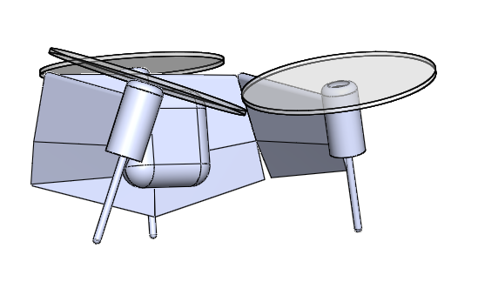
Payload protected during landing

